Slide 1

Customer Shopping Behavior Analysis
Uncovering insights from 3,900 purchases across product categories to guide strategic business decisions.

Slide 2

Dataset Overview
3,900 Purchases
18 Features
50 Locations
Transactions analyzed across multiple categories
Demographics, purchase details, behavior patterns
Geographic distribution of customer base

Slide 3

Customer Demographics
44
50%
27%
Average Age
Gender Split
Subscribers
Range: 18–70 years
Balanced male/female distribution
1,053 active subscriptions

Slide 4

Revenue Insights
By Gender
By Subscription
Male: $157,890
Subscribers: $62,645
Female: $75,191
Non-subscribers: $170,436

Slide 5




Customer Segments
Returning
701 customers
Loyal
3,116 customers
New
83 customers

Slide 6

Top Products & Categories
Highest Rated
Most Purchased
Gloves (3.86★)
Blouse (171 orders)
Discount Heavy
Hat (50% discounted)

Slide 7
Discount & Promo Behavior
839 high-spending customers used discounts while maintaining above-average purchase amounts.
50%
49.66%
49.07%
Hat
Sneakers
Coat

Slide 8

Shipping & Purchase Patterns
Shipping Preference
Purchase Frequency
Free: 2,223 orders
Every 3 months: most common
Express: $60.48 avg
Repeat buyers >5 purchases: 958 with subscriptions
Standard: $58.46 avg

Slide 9
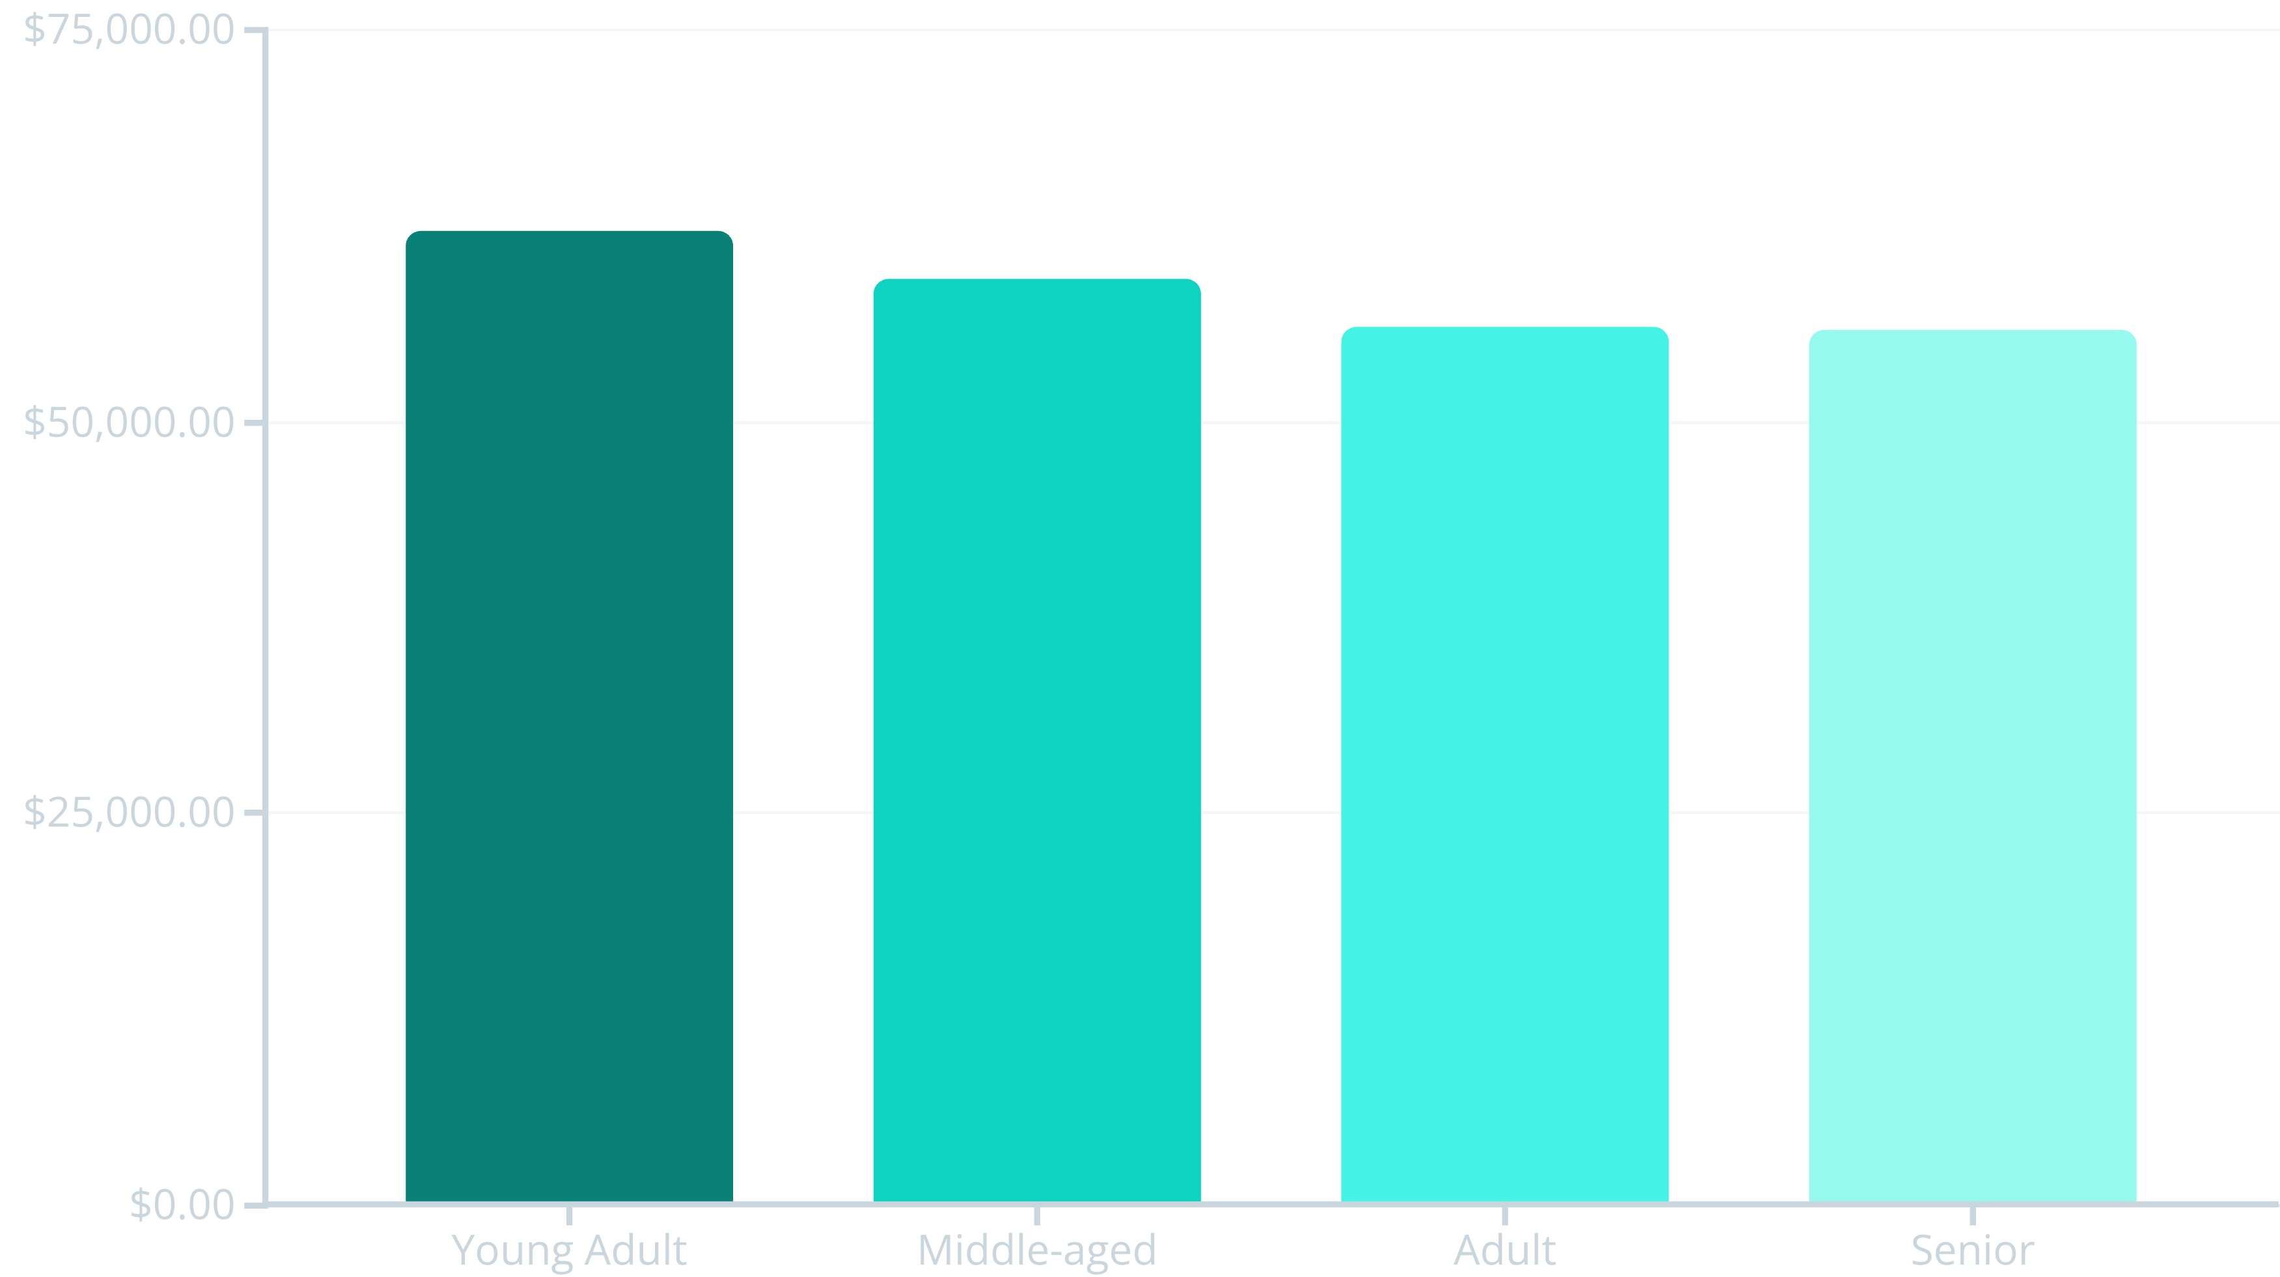
Revenue by Age Group

Slide 10

Strategic Recommendations
1
Boost Subscriptions
Promote exclusive subscriber benefits and loyalty rewards
2
Optimize Discounts
Balance sales volume with margin control on high-discount items
3
Target Marketing
Focus on high-revenue age groups and express-shipping users
4
Highlight Winners
Feature top-rated and best-selling products in campaigns

